Slide 1
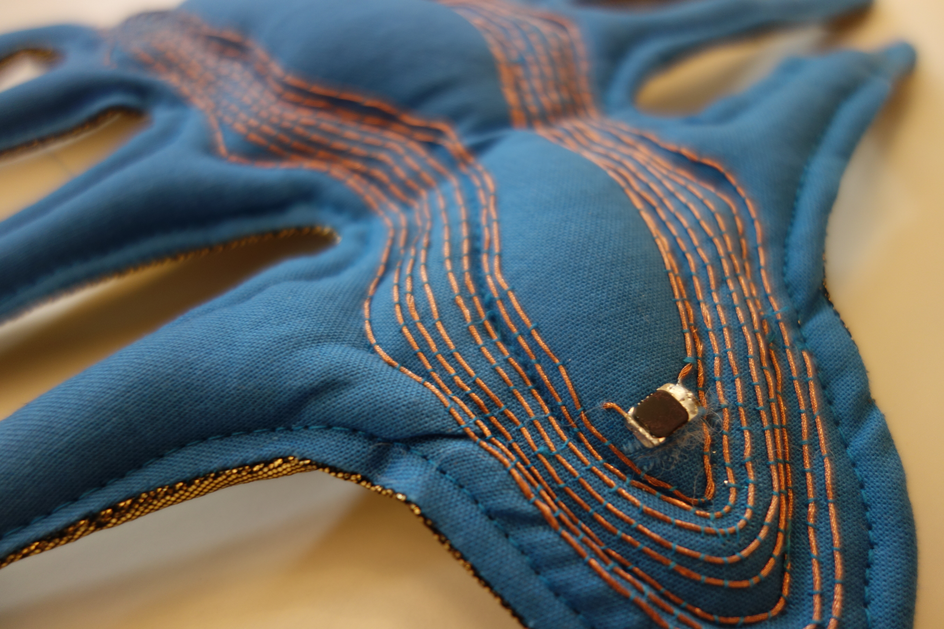
Crafting Frequencies
E-texiles + EMFs
#CCmakeshiftdo
Notes:
Derby Silk mill crafting frequencies

Slide 2
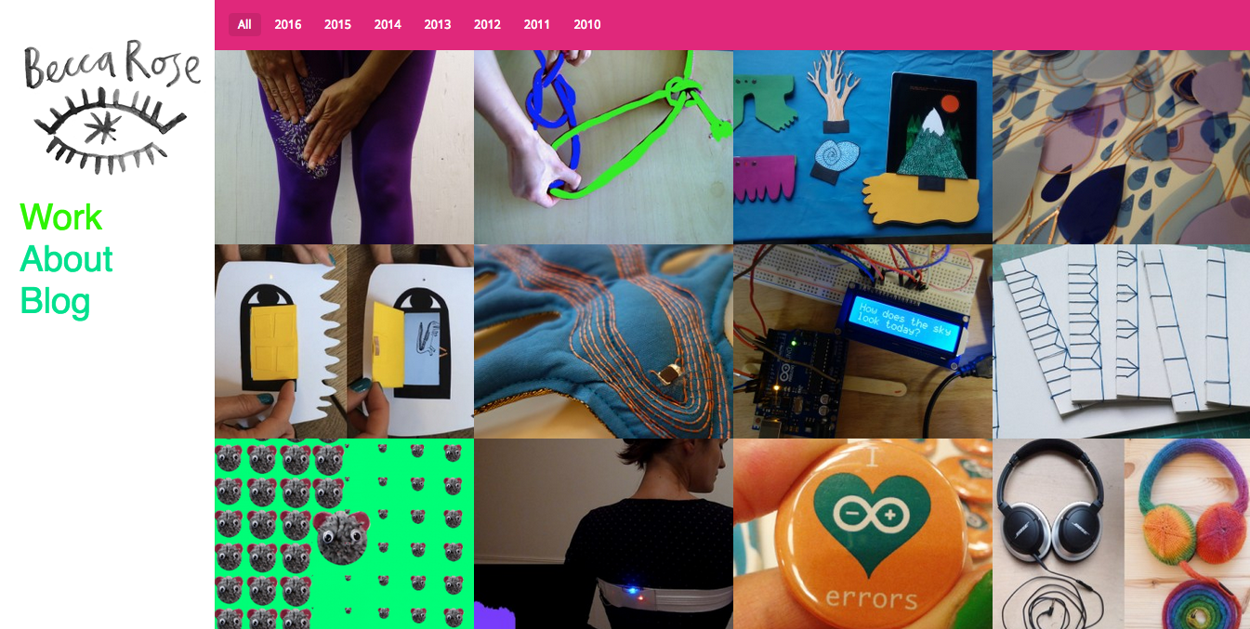

Slide 3
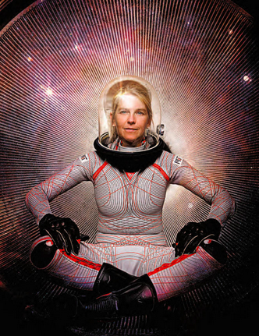
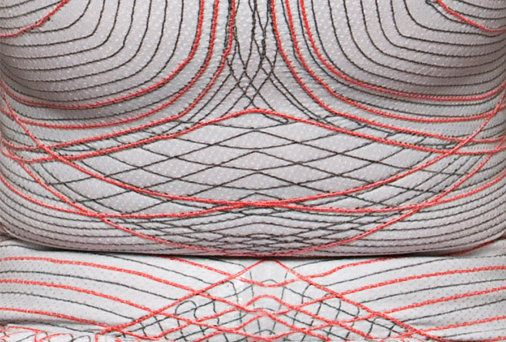
What are etextiles?
Development of materails by nasa and other places
Notes:
What happens when you bring smart materials into the hands of creative inventors?
–developed by NASA in this case for pressure, and other industrial uses like shielding from Electromagnet Fields or packaging for electronic components.
This suit by Dava Newman, MIT

Slide 4
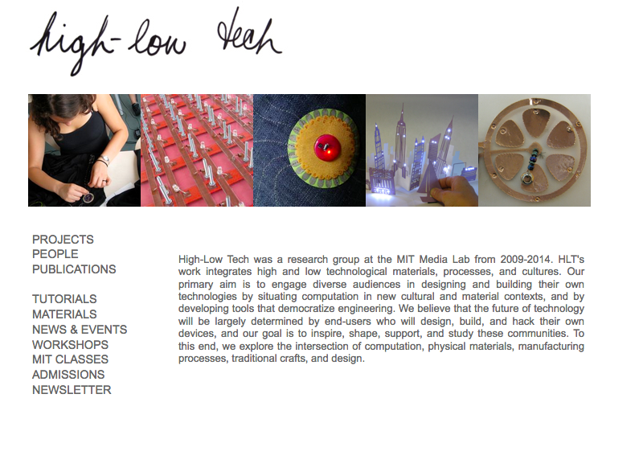
High-Low Tech: highlowtech.org
Notes:
http://highlowtech.org/

Slide 5
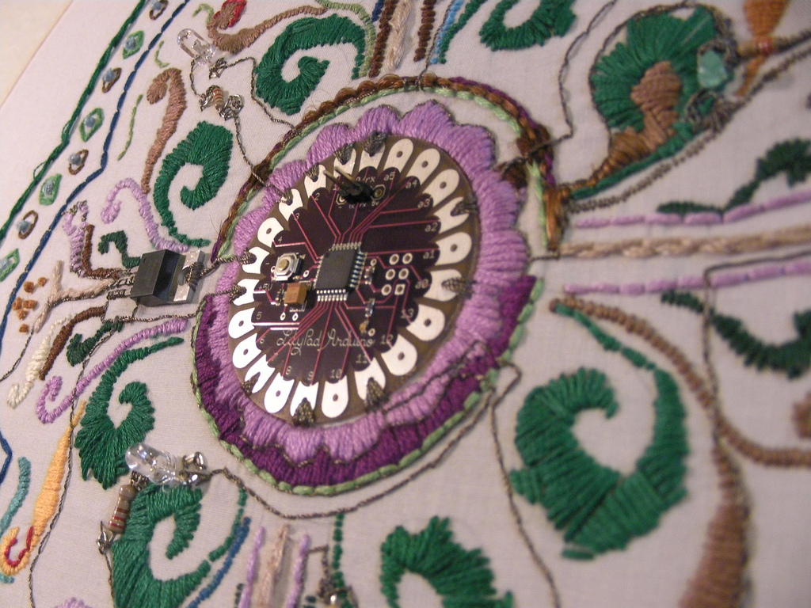
Decorative

Slide 6
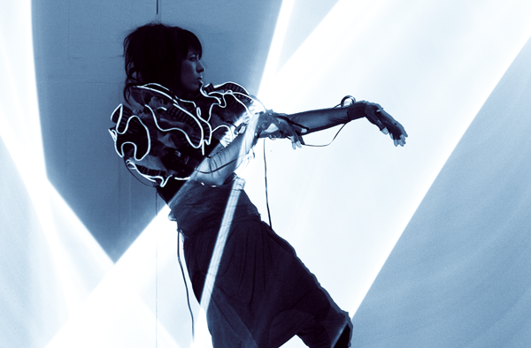
Functional

Slide 7
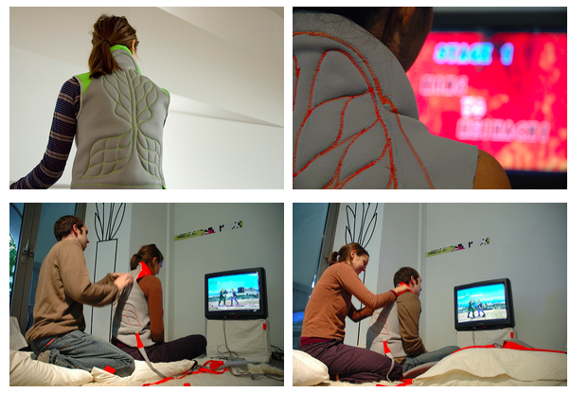
Playful

Slide 8
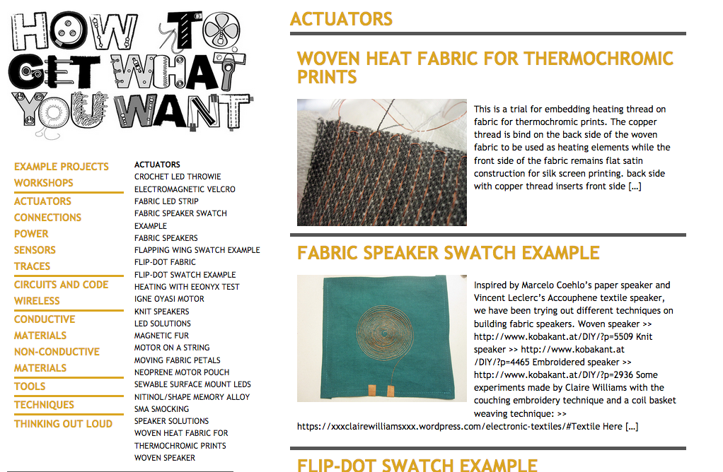
How to get what you want: http://www.kobakant.at/DIY
Notes:
Like most things there are also bugger picture implication around etextile movement. Its not just about sewing textiles and goes beyond that in the following ways
Hacking + DIY mentality (learning about the things around us in black boxes)

Slide 9
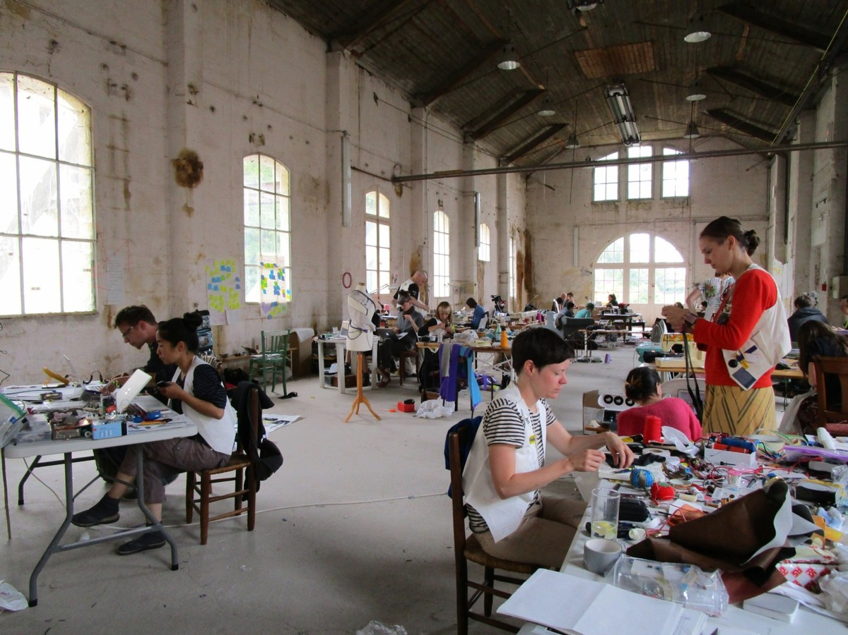
Communities of makers
Notes:
Summer camp
Local meet-ups:
London + bristol e-stiches
Berlin etc.

Slide 10
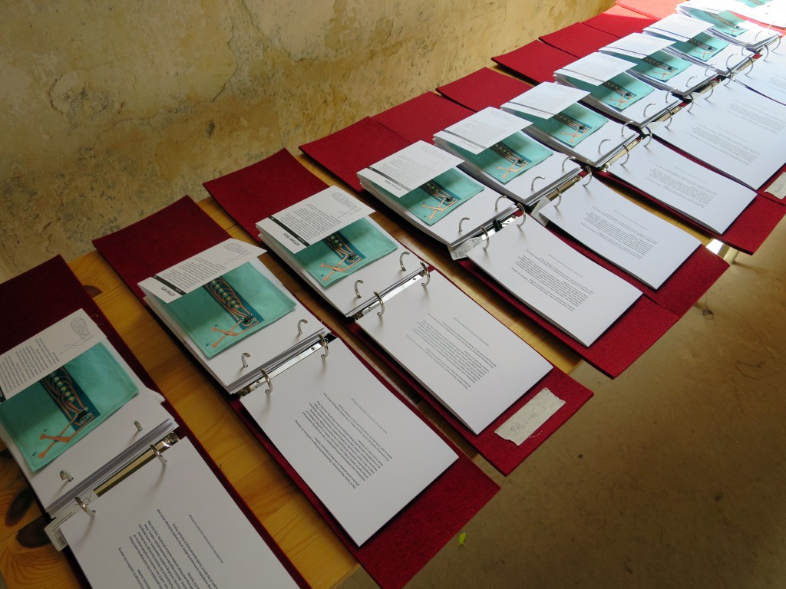
Sharing techniques

Slide 11
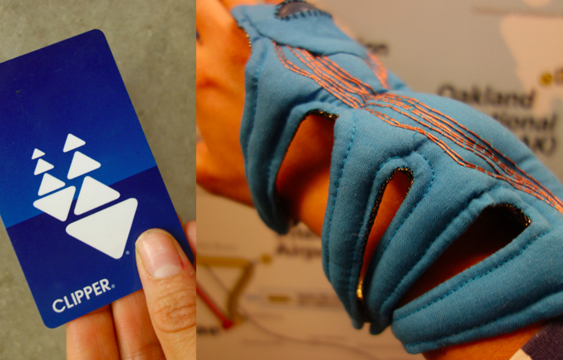
What are EMFs?
Notes:
Why?
A mass produced hard thing in comparison to a wonderful sewn e-textiles thing
Example of seeing the circuitry on the outside –it is a decorative thing
Clipper Critter: https://vimeo.com/143306005

Slide 12
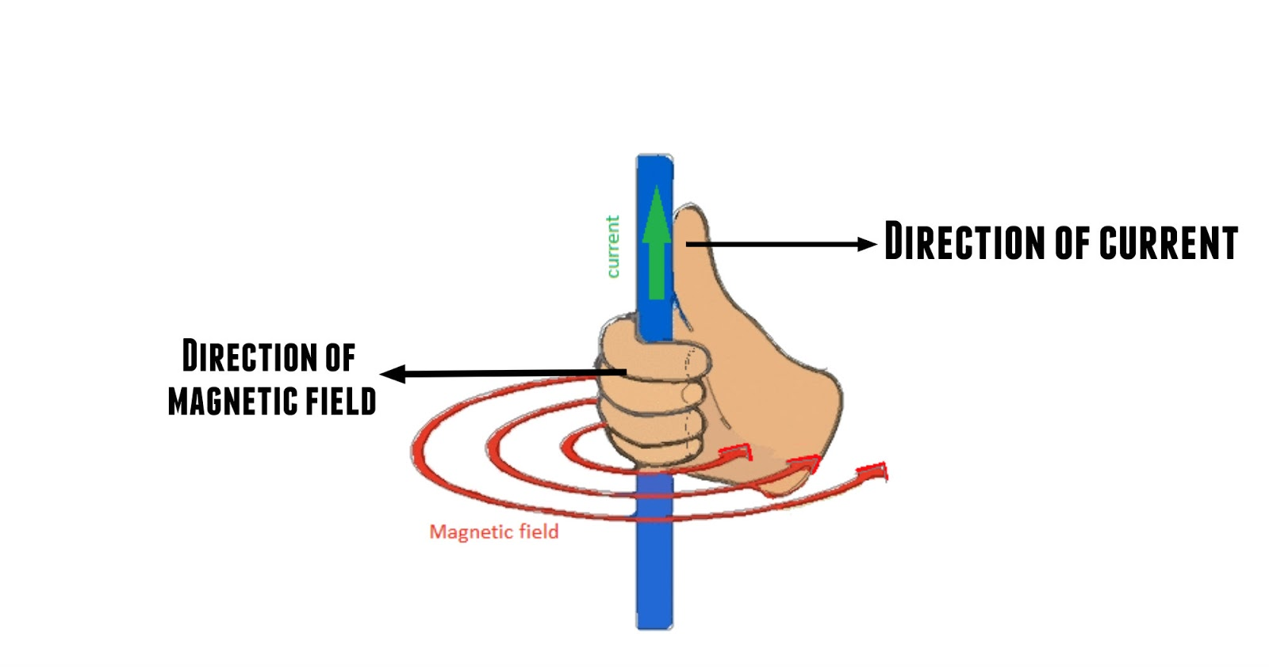

Slide 13
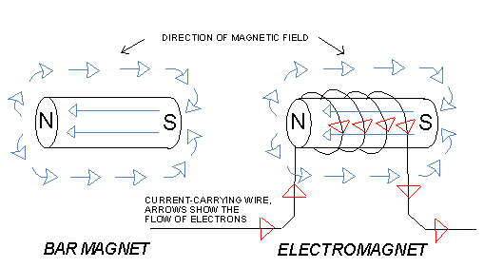

Slide 14
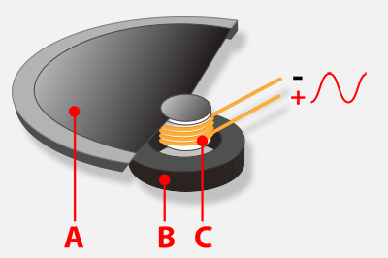
How does a speaker work?
Notes:
+ Demo

Slide 15
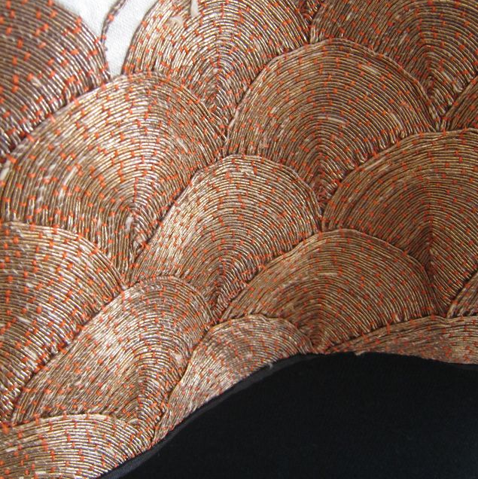
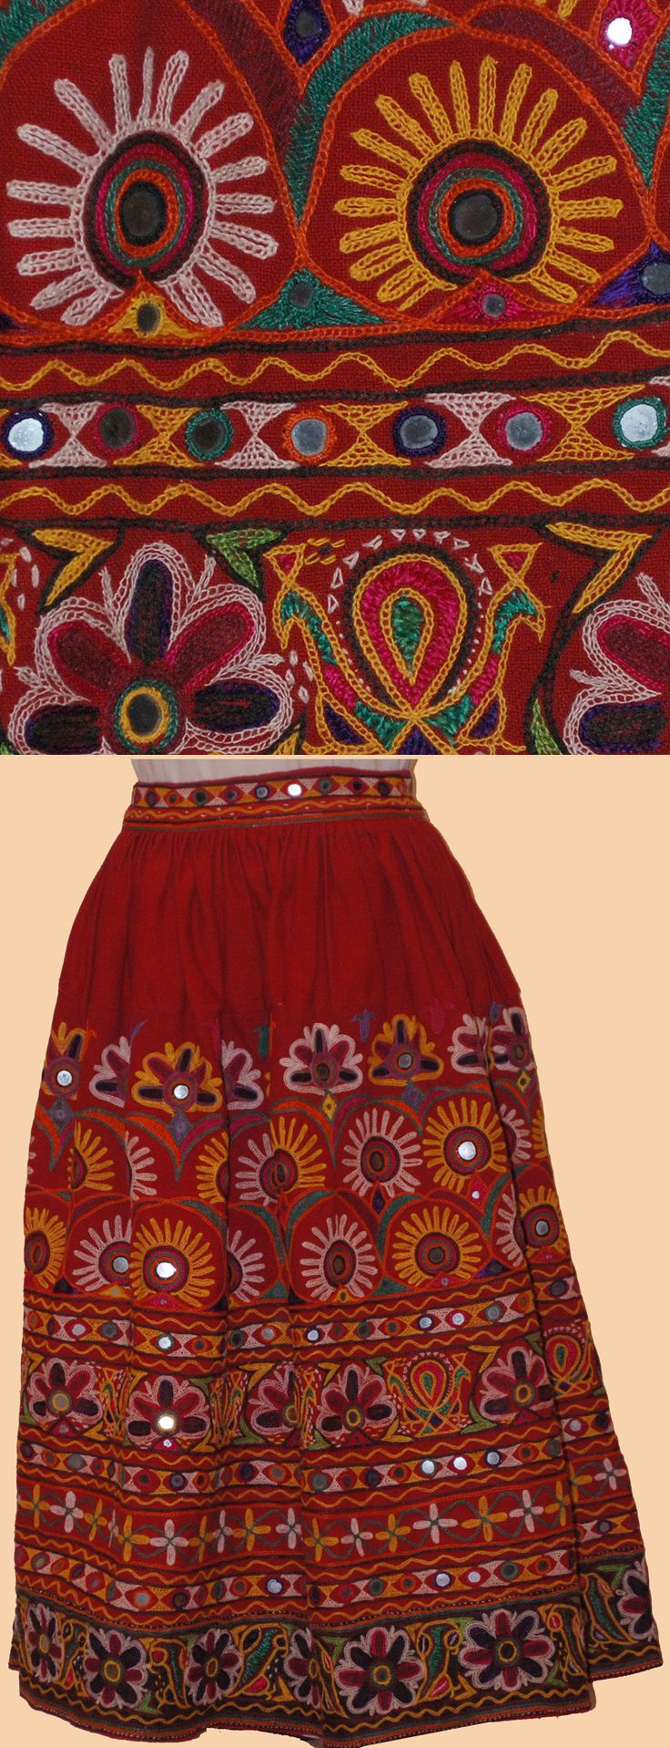
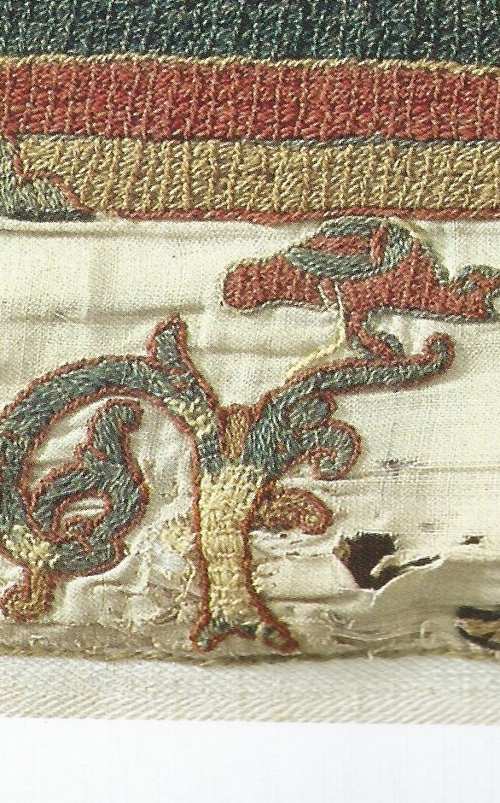
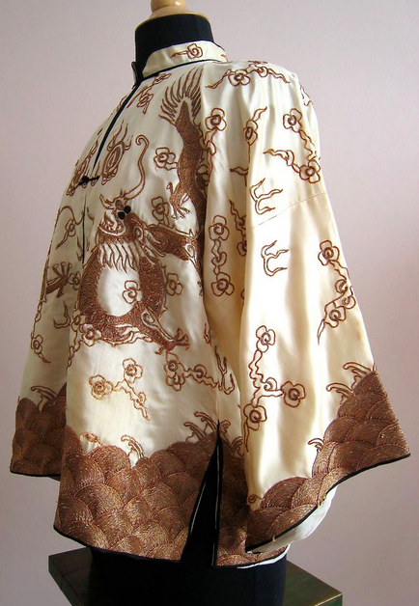
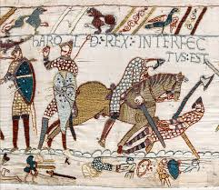
Examples of couching
Notes:
Time old knowledge of the hand
Barmer tribe (Rajasthan – India embroidery)
(play video until the credits)
http://www.bbc.co.uk/iplayer/episode/b03c2766/fabric-of-britain-3-the-wonder-of-embroidery

Slide 16
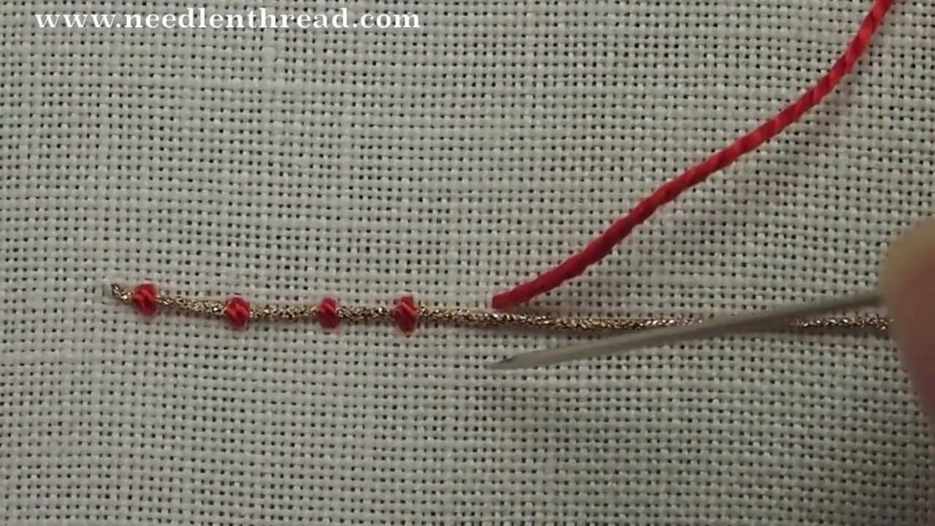
Notes:
http://stitchschool.blogspot.co.uk/2006/12/couching.html

Slide 17
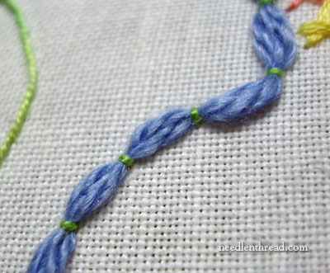

Slide 19
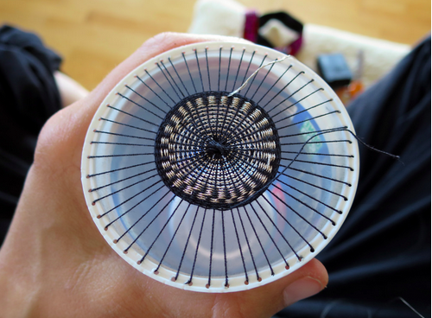
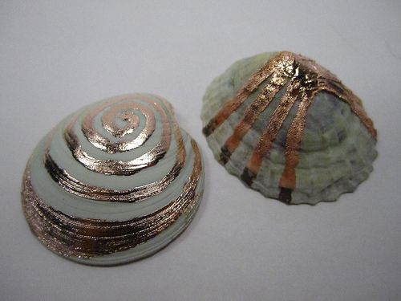
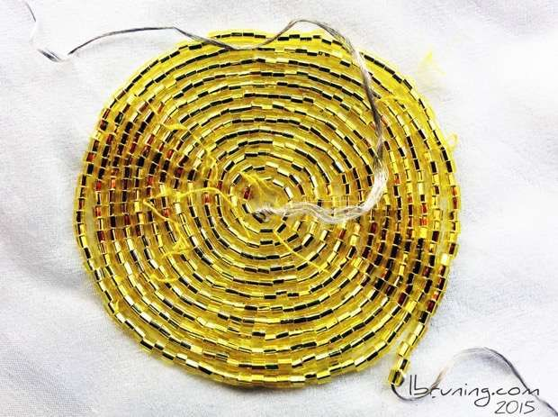
Woven, paper, crochet...or more!
Notes:
http://www.kobakant.at/DIY/?p=5509
Speakers and why they are so cool!
Vibrations from anything –what does a shell sound like...actually the sound of a shell!

Slide 20
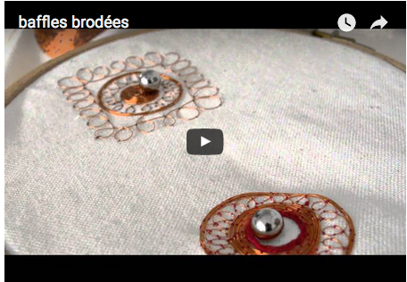
https://www.youtube.com/watch?v=SofKnJ9XJuI
Notes:
Couched speakers

Slide 21
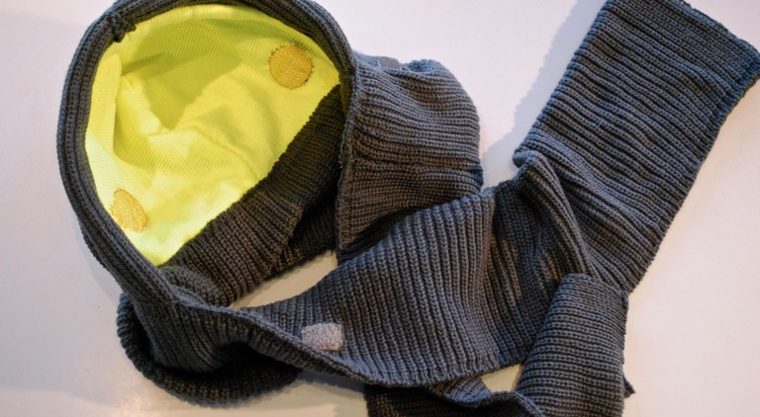
http://v2.nl/archive/works/betaknit

Slide 22
